Slide 1
All Cards
Hearts
Diamonds

Slide 2
All Cards
Hearts
Queens

Slide 3
t(48)=1.04, p=.30
Mean = 100
Mean = 105

Slide 4
t(48)=2.25, p=.03
Mean = 100
Mean = 110

Slide 5
t(48)=3.72, p=.0003
Mean = 100
Mean = 115

Slide 6
t(48)=1.04, p=.30
Mean = 100
Mean = 105

Slide 7
t(48)=1.68, p=.09
Mean = 100
Mean = 105

Slide 8
t(48)=3.77, p=.0002
Mean = 100
Mean = 105

Slide 9
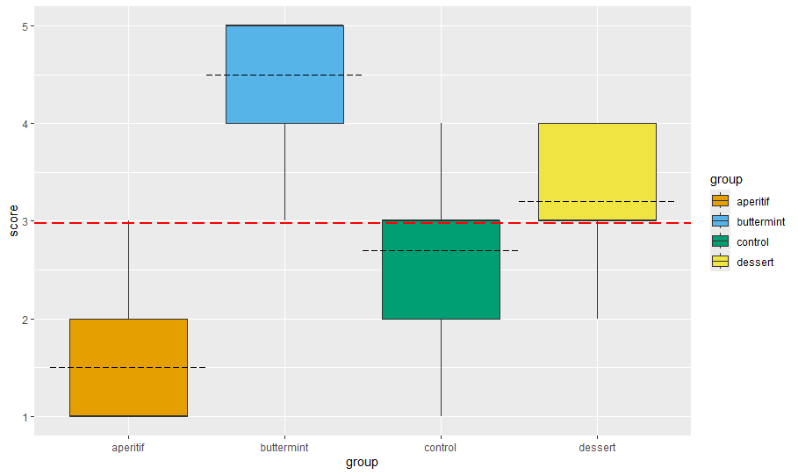

Slide 11
A
C
Contrast 3
(not recommended)
B
D
Contrast 2
A, B, D
C
Contrast 1
A, B, C, D

Slide 12

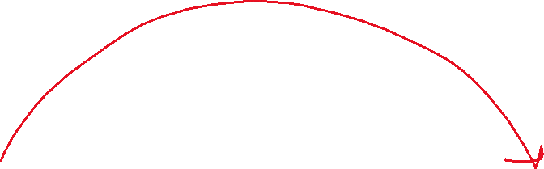
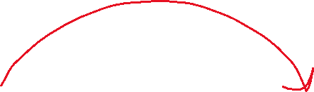
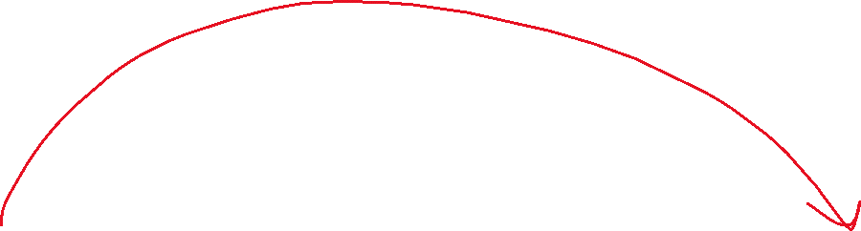
Baseline
Module 1
Module 2
Module 3
Follow up

Slide 13




Baseline
Module 1
Module 2
Module 3
Follow up

Slide 14

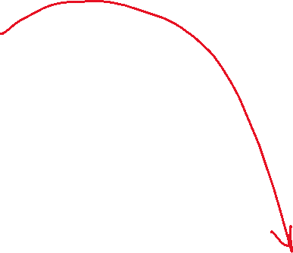
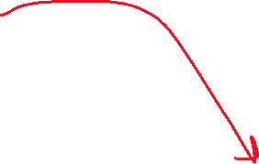
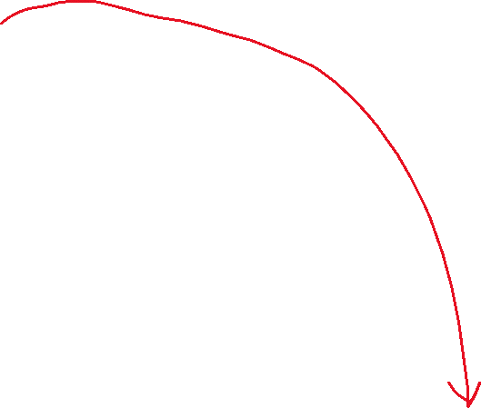
Baseline
Module 1
Module 2
Module 3
Follow up

Slide 15
Alan
Baseline
Mod. 1
Mod.2
Benoit
Baseline
Mod. 1
Mod. 2
Level 1
Level 2

Slide 16
Happiness
Meditation
Stress

